Slide 1
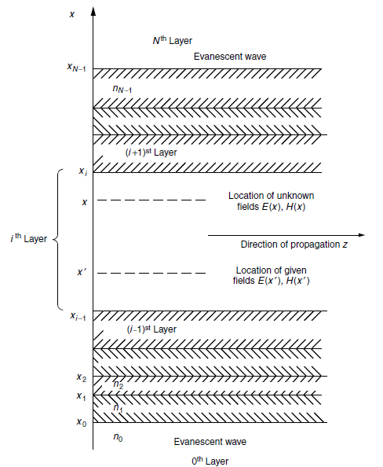


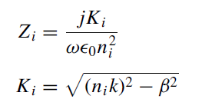



Multilayer Waveguides
The values of A and B are obtained by solving the simultaneous above Equations:

Slide 2
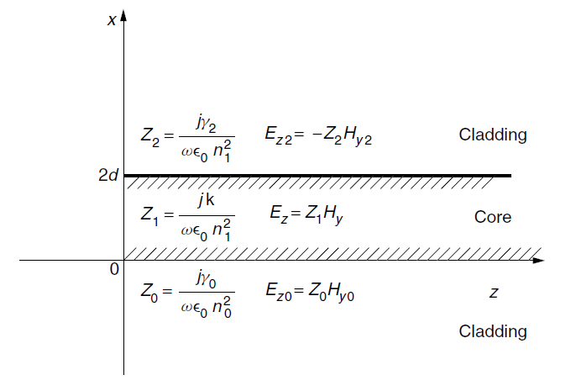





Simple Planar Waveguide
The fields in the bottom layer
as well as in the top layer are unbounded waves.

Slide 3


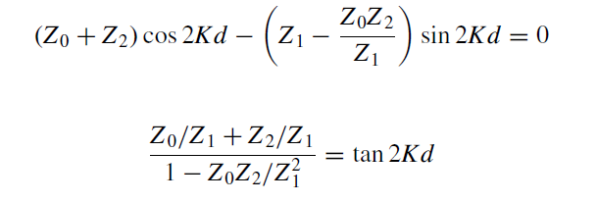

In order that Hy(0) and Hy(2d) have nonzero solutions, the determinant has to be zero.
Thus, the first factor is the characteristic equation for the even TM modes and the second, for the odd TM modes.

Slide 4



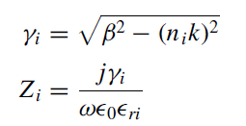

An (N-1)layer guide in unbounded space
In the event that a particular mode that has an evanescent wave in the ith layer isdesired, the transmission matrix of the ith layer has to be derived in a similar manner as:

Slide 5





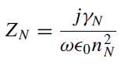
to connect the field starting from the first layer up the (N-1)st layer gives:
Thus, the characteristic equation is:

Slide 6
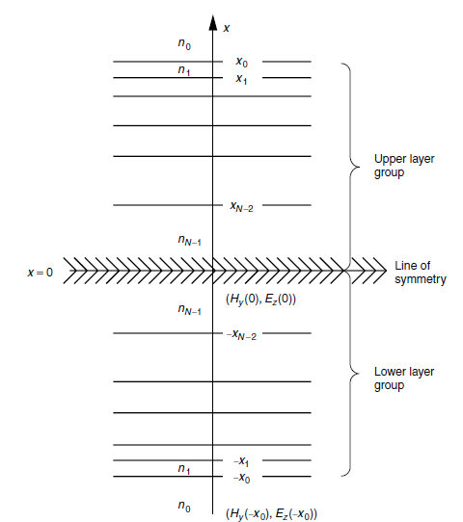



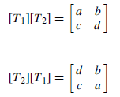



Transmission Matrix Method (Symmetric Guide)

Slide 7
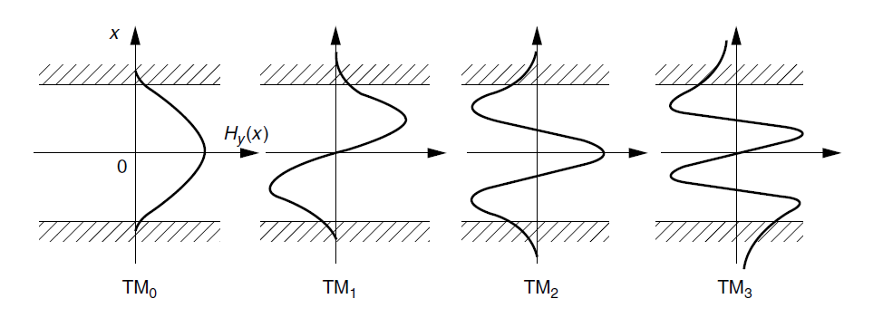




the characteristic equation for the Even TM modes

Slide 8



the characteristic equation for the Odd TM modes

Slide 9
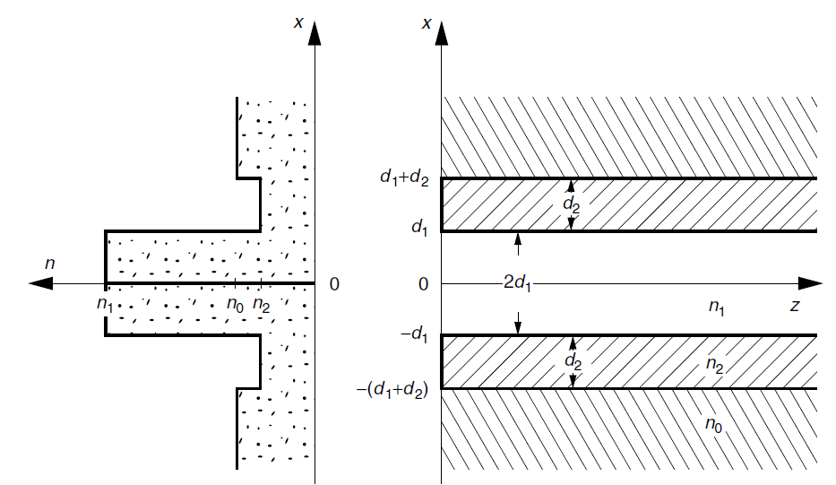



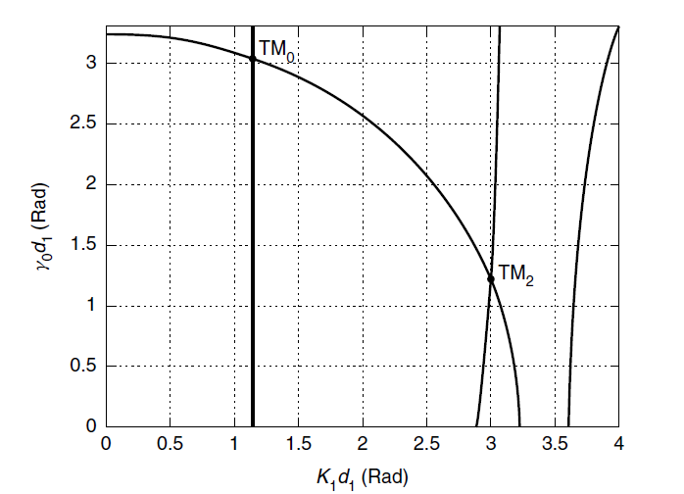


Example:

Slide 10
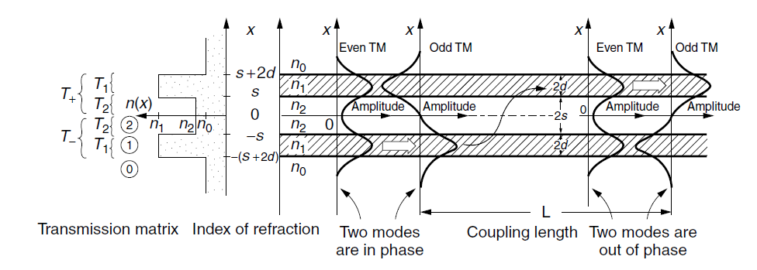
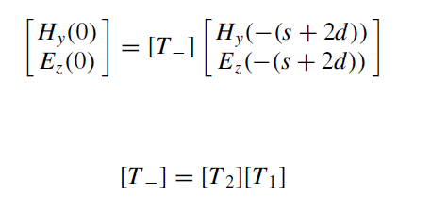
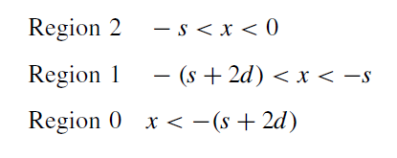
Amplitude Distribution in the Coupled Slab Guide

Slide 11



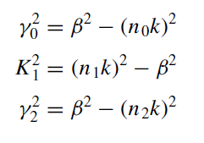

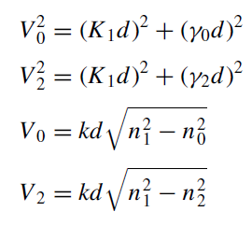

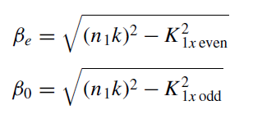

Slide 12

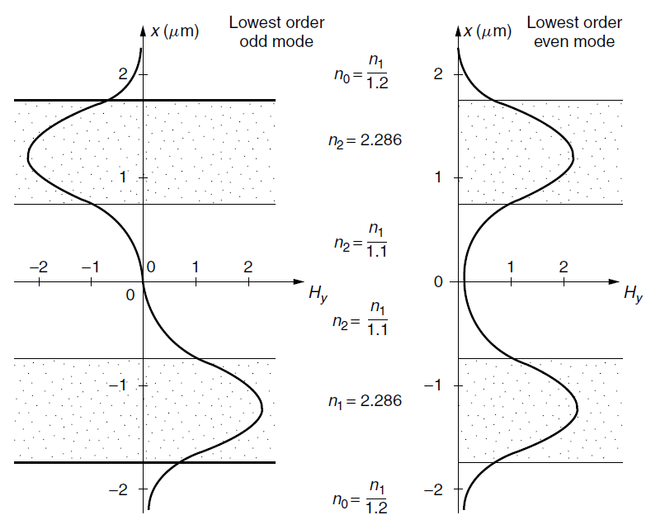
The length of the transfer of the energy is called the transfer length.

Slide 13
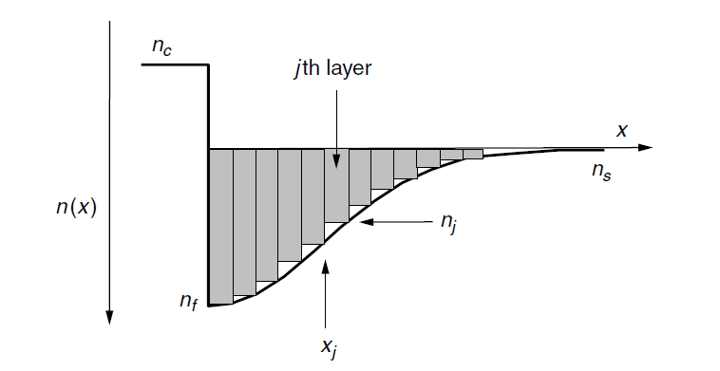
Graded-index Planar Waveguides Multi-layer approximation

Slide 14
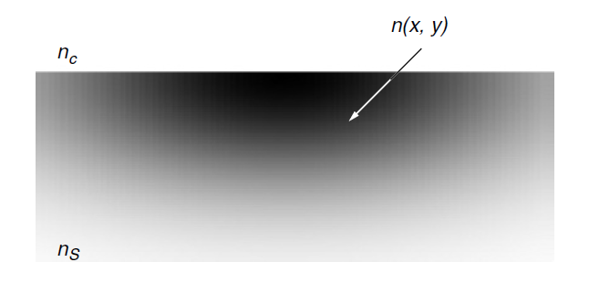
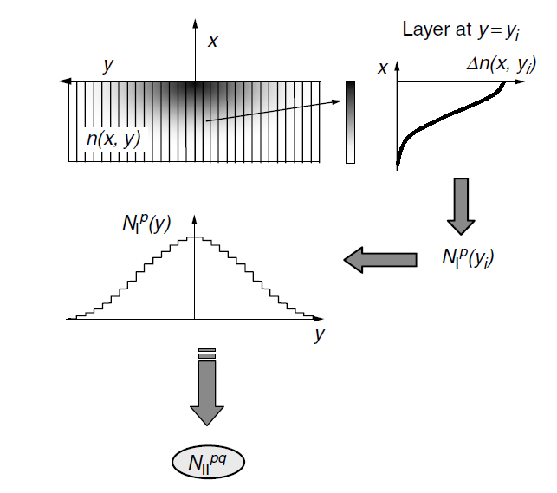

Graded-index channel waveguide.

